Slide 1
ELEMENTARY STATISTICS, BLUMAN
Normal Distribution Example 1
© 2019 McGraw-Hill Education. All rights reserved. Authorized only for instructor use in the classroom. No reproduction or further distribution permitted without the prior written consent of McGraw-Hill Education.

Slide 2
Objectives for this PowerPoint
How to use the standard normal distribution to find a probability associated with a normally distributed random variable.

Slide 3
Problem
According to census.gov the average square footage of a house in the United States in the year 2015 was 2687 square feet. Assume that the square footage of US homes is a normally distributed variable with a standard deviation of 626 square feet. If a house in the US is selected at random, what is the probability that the square footage is less than 3651?
In probability notation this would be expressed as
P(x < 3651)

Slide 4

Find the z Score
P(x < 3651)
$$z=\frac{x−μ}{σ}$$
$$z=\frac{3651−2687}{626}$$
$$z=1.54$$
Finding the probability the random variable x would take on a value less than 3651 is the same as finding the probability that z would be less than 1.54 in a standard normal distribution.
P(z < 1.54)

Slide 5
About the z Score
The z score 1.54 would be a little more than halfway between z equal to 1 and z equal to 2. We are to find the probability that z would be less than 1.54 which corresponds to the area under the curve to the left of z equals 1.54.

Slide 6
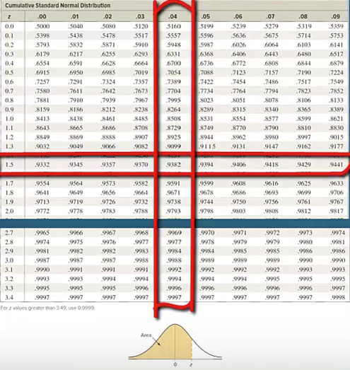
Find the Probability
Looking at the left column of the cumulative normal distribution table we travel down until we find a z score of 1.5 and then travel to the right until we find where that row crosses up with the column that is headed .04. Here we find a value of .9382.

Slide 7

Shaded Region
We see at the bottom of this table the picture of the normal distribution. The four decimal place values in the body of the table correspond to the shaded region in the picture of the normal distribution.

Slide 8
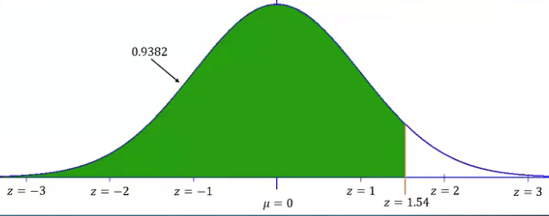
Shaded Area Under the Curve
The shaded area under the curve corresponds to the probability that z would be less than 1.54.

Slide 9
Conclusion
The probability that the square footage of a randomly selected home in the United States would be less than 3651 is equal to .9382.
This can be stated in another way. Assuming that the square footage of US homes is a normally distributed variable with a mean of 2687 square feet with a standard deviation of 626 square feet, 93.82% of the homes in the United States would be smaller than 3651 square feet.

Slide 10
Summary
In this PowerPoint, we learned how to use the standard normal distribution to find a probability associated with a normally distributed random variable.

